Slide 1
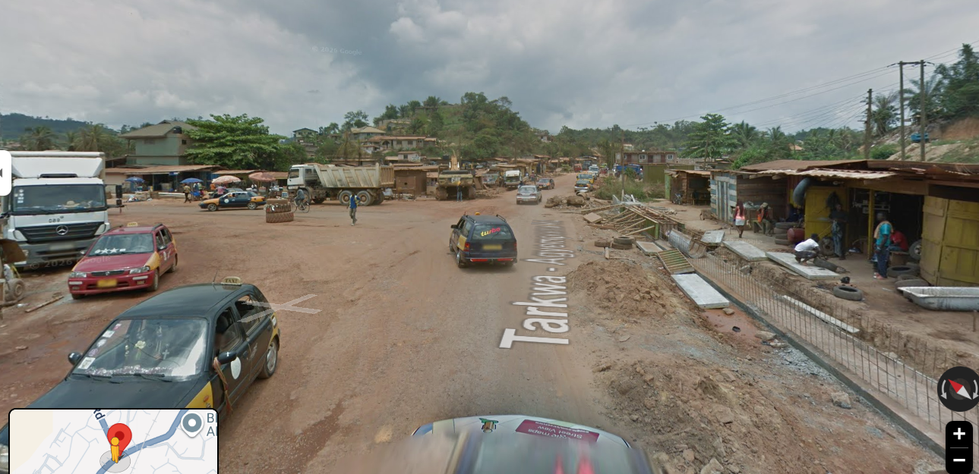

HACKATHON 2026
SmartJunction
Adaptive speed ramps, rising bollards, and camera enforcement for junctions that have no lane paint and no traffic lights.
Bogoso Junction — Bogoso–Tarkwa Rd, Prestea-Huni Valley, Ghana
A junction that reads the light and decides for itself when to slow, stop, and log.

Slide 2

THE PROBLEM
Rural T-junctions ask drivers to self-regulate — and most don't
No lane markings, no signal heads — right of way is negotiated car-by-car
Laterite/dirt surface cuts braking grip well below the sealed-road assumption speed bumps are designed for
Bogoso Junction, present day — unmarked merge, mixed heavy/light traffic
Heavy trucks and shared taxis merge from a blind side road directly into through traffic
This is exactly the junction shape we modeled
Enforcement today means a traffic officer standing in the sun, or nothing at all
A through road (Bogoso–Tarkwa Rd) with a side road ending directly at it — a textbook T-junction, and the shape our simulation is built around.

Slide 3
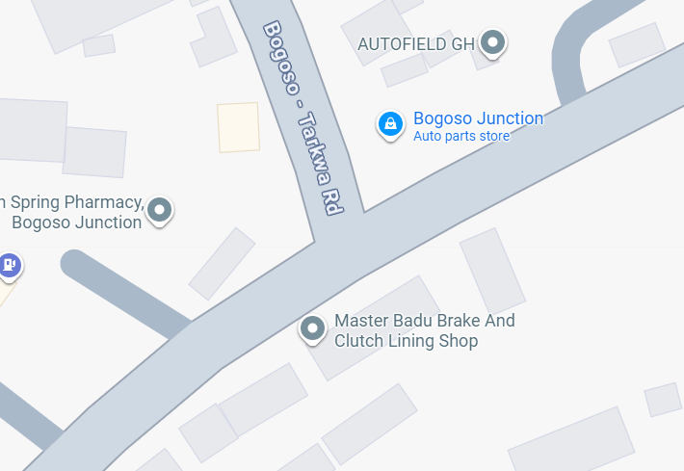
THE SITE
From satellite view to simulation model
VERTICAL — THROUGH ROAD
2 lanes, north–south
HORIZONTAL
STUB
2 lanes,
ends at junction
Bogoso Junction, Google Maps — Bogoso–Tarkwa Rd (through) meets a side road (stub)
This T-junction geometry — one through road, one road that ends at it — is the exact model our simulation runs.

Slide 4



THE SOLUTION
Three mechanisms, one shared logic
Smart speed ramps
Rising bollards
Speed cameras
Two physical humps per lane, always active. When the light turns yellow they grip harder — forcing a hard, fixed low speed no matter what limit is posted.
A separate, lane-width post placed after the ramps. It only rises on red, giving a clean physical stop instead of a blended slow-down.
Positioned ahead of the ramps on every approach, logging any vehicle still over the limit before traffic-calming even begins.

Slide 5





THE DEVICES
Five devices, one shared control loop
Smart speed ramps
Traffic signal head
Two per lane. Always-on mild cap; clamps to a hard low speed the moment the light turns yellow, no matter the posted limit.
One per road (vertical and horizontal). Runs the green → yellow → red phase every other device keys off.
Rising bollard
Central control display
One per lane, just past the ramps. Rises to about half a tyre's height on red — enough to physically hold the lane without acting like a wall.
Live dashboard showing right of way, per-lane queues, and the violation log — one view of every device's state.
Speed camera
One per approach, ahead of the ramps. Captures any vehicle already over the limit before calming begins, and logs it.

Slide 6
HOW IT WORKS
One phase change, four things happen in order
1
→
2
→
3
→
4
Green — free flow
Yellow — ramps activate
Red — bollard rises
Camera logs the record
Ramps sit idle, bollard is flat. Traffic moves at the posted limit through its lane.
A 10-second countdown appears at each bollard. Ramps glow and clamp every car to a hard low speed, regardless of the speed limit set.
At 0, the bollard rises across the lane and physically holds vehicles at the line until the phase changes.
Anything that passed the camera above the limit before the ramps caught it is flagged and counted centrally.

Slide 7
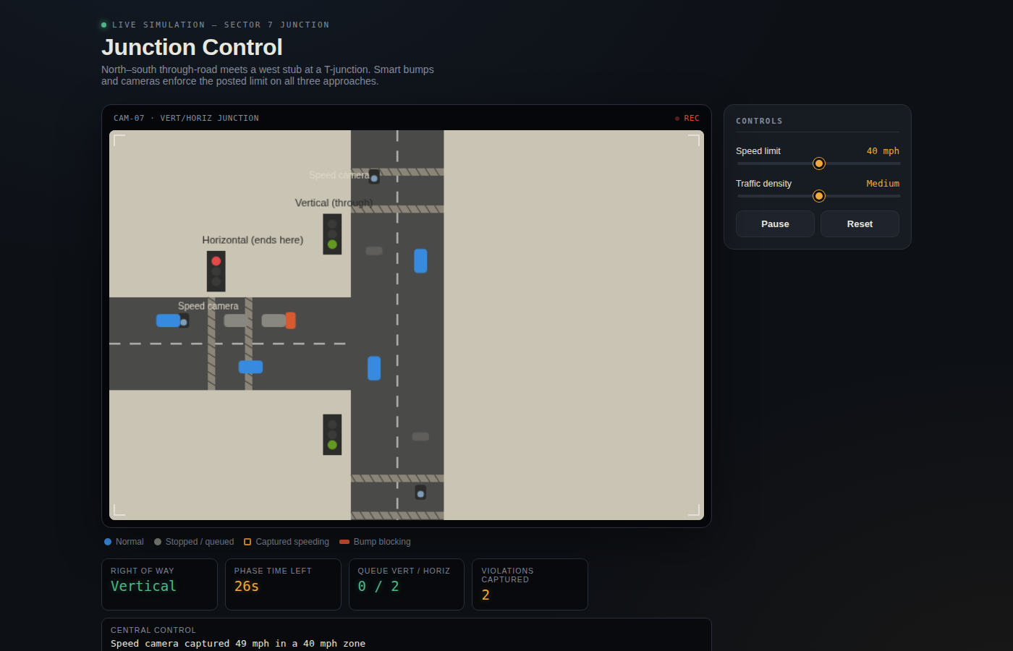
LIVE PROTOTYPE
Working in the browser today
RIGHT OF WAY
Vertical / Horizontal
QUEUE TRACKING
Per-lane, live
VIOLATIONS
Auto-logged
BUILT WITH
HTML5 Canvas + JS

Slide 8
WHY IT MATTERS
Calming that escalates, and enforcement that remembers
Gradual, not sudden
A car that misses the ramp still meets a bollard, not a collision — speed is bled off in stages before the merge.
Limit-proof by design
The yellow-phase clamp is a fixed speed, not a fraction of the posted limit, so raising the limit can't defeat it.
Accountability without a permanent officer
Every camera capture is logged centrally, so enforcement doesn't stop when nobody is standing at the junction.
Cheap to pilot
The whole control model runs in a browser today — the path to hardware is wiring ramps and bollards to the same logic, not rebuilding it.
Every stage of this model was designed against this exact road, not a generic intersection.

Slide 9



NEXT STEPS
From simulation to a junction that acts on itself
Sensor validation
Actuated hardware
Solar + off-grid power
Pilot partnership
Radar/inductive speed sensing to feed real vehicle speeds into the same phase logic.
Motorized ramp segments and a physical rising bollard, driven by the exact state machine already built.
A self-contained unit that doesn't depend on the grid reaching the junction.
One physical pilot at Bogoso Junction with the local road authority before wider rollout.

Slide 10
Let's make Bogoso Junction slow down on its own
SmartJunction — ramps, bollards, and cameras that share one traffic-light brain
THANK YOU

